Slide 1




TURN
NORTH LINCOLNSHIRE
BLUE!
World Mental Health Day 2026
Mental health matters.
Talking about mental health matters too.
#TurnNLBlue
Notes:
For staff : This ready-to-use assembly is designed for secondary school and college students and takes approximately 10–15 minutes to deliver. Optional discussion questions are included throughout and can be omitted for a shorter assembly.
Before delivering the assembly, please familiarise yourself with your school's or college's safeguarding, pastoral and wellbeing support arrangements.
Please ensure students know where they can access support following the assembly and follow your organisation's usual safeguarding procedures if a student raises a concern or makes a disclosure.
Speaker notes
Today our school/college is joining organisations across North Lincolnshire for World Mental Health Day.
We're taking part in Turn North Lincolnshire Blue, a campaign from North Lincolnshire Mind designed to get our community talking about mental health.
Mental health is something that affects every one of us.
Sometimes we're doing well and sometimes things are more difficult. That can change throughout our lives.
Talking about mental health can sometimes feel awkward or uncomfortable. But the more able we are to talk openly about how we're doing, the easier it can be to ask for help, support other people and challenge stigma.
Over the next few minutes, we're going to think about what can affect our mental health, some things that can help, when it might be time to talk to someone and how we can look out for each other.

Slide 2

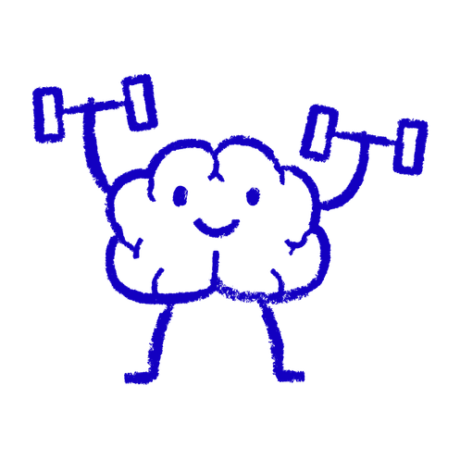
What do we mean by mental health?
We all have mental health.
Mental health affects how we think, feel and cope with everyday life.
It can change over time and everyone experiences difficult days.
#TurnNLBlue
Notes:
When we hear the words mental health, conversations often immediately turn to mental illness.
But we all have mental health.
Our mental health is part of how we think, how we feel and how we cope with everyday life.
Just like our physical health, it can be better at some times and more difficult at others.
Having a difficult day doesn't necessarily mean there's something wrong with your mental health. Ups and downs are a normal part of life.
What's important is recognising when things aren't feeling right for us and knowing that it's okay to do something about it.
Optional question: What kinds of things do you think can affect someone's mental health?

Slide 3
What can affect our mental health?
RELATIONSHIPS
LONELINESS
FRIENDSHIPS
EXAMS
SOCIAL MEDIA
MONEY
CHANGE
FAMILY
SLEEP
Sometimes there isn’t an obvious reason
THE FUTURE
#TurnNLBlue
Notes:
Lots of things can affect how we feel.
Some might be obvious - exams, friendships, relationships, problems at home, money worries or big changes in our lives.
Other things can build up over time. Not getting enough sleep, feeling lonely, worrying about the future or comparing ourselves with other people online can all affect how we feel.
What's difficult for one person might not be difficult for somebody else. Two people can experience the same situation and feel completely differently about it.
And sometimes we can struggle without being able to identify a reason at all.
We don't need to compare our problems with somebody else's to decide whether we're ‘allowed’ to be struggling.
You don't have to be able to explain or justify why you're struggling for your feelings to matter.
Optional question: Without sharing anything personal, are there other things you think can affect young people's mental health?

Slide 4

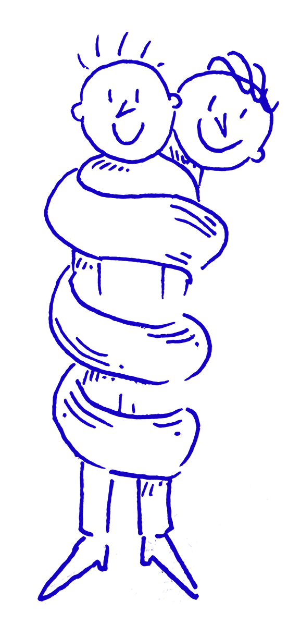



Looking after your mental health
There isn’t one magic answer.
But small things can help.
TIME AWAY FROM SCREENS
THINGS YOU ENJOY
TALKING
SLEEP
MOVEMENT
CONNECTION
#TurnNLBlue
Notes:
Looking after your mental health isn't about being positive all the time.
And there isn't one wellbeing tip that fixes everything.
But small things can help support our wellbeing - getting enough sleep, moving our bodies, spending time with people we feel connected to, taking breaks from screens, doing things we enjoy and talking to somebody.
That doesn't mean going for a walk, getting an early night or putting your phone down will magically fix a mental health problem.
These are simply some of the things that can help us look after ourselves.
Different things work for different people. For one person it might be sport. For somebody else it could be music, gaming, reading, art, spending time with friends, being outside or having some time alone.
And it's also important to recognise when these things aren't enough and it might be time to ask for support.
Optional question: Without sharing anything personal, what's one thing you think can help someone reset after a stressful day?

Slide 5

When should I talk to someone?
You don’t need to wait until things are unbearable.
If something is:
💙 Affecting your everyday life
💙 Not getting better
💙 Making it hard to cope
💙 Or you feel ‘something isn’t right’
Talk to someone.
You don’t have to handle everything alone.
#TurnNLBlue
Notes:
One of the biggest messages we want you to take away today is that you don't have to reach some imaginary level of “bad enough” before you're allowed to ask for help.
If something is affecting your everyday life, isn't getting better, is making it difficult to cope or you simply feel that something isn't right, talk to someone.
That could be a parent or carer, teacher, tutor, another trusted adult, someone in your school's or college's pastoral or wellbeing team, your GP or another professional.
You don't need to know exactly what's wrong or have the perfect words to explain it.
You could simply start with:
“I've not been feeling like myself recently and I think I need to talk to someone.”
Asking for help isn't making a fuss, and you don't have to handle everything alone.
🏫 SUPPORT AT OUR SCHOOL/COLLEGE
Before delivering this assembly, please complete this section:
Who students can speak to: ______________________________
Where they can find them: _______________________________
How students can ask for support: ________________________
For staff: Please take a moment here to explain your school's/college's support arrangements to students.

Slide 6
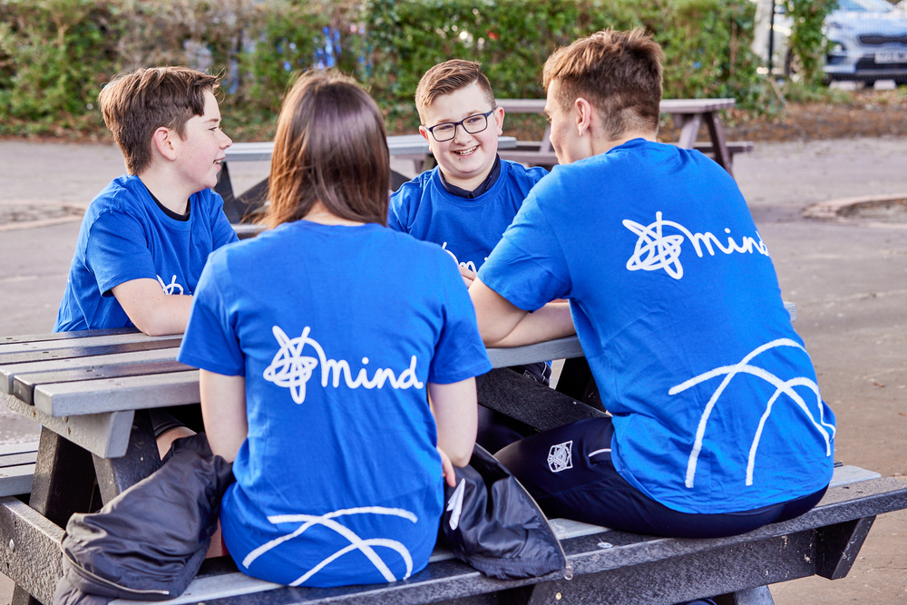
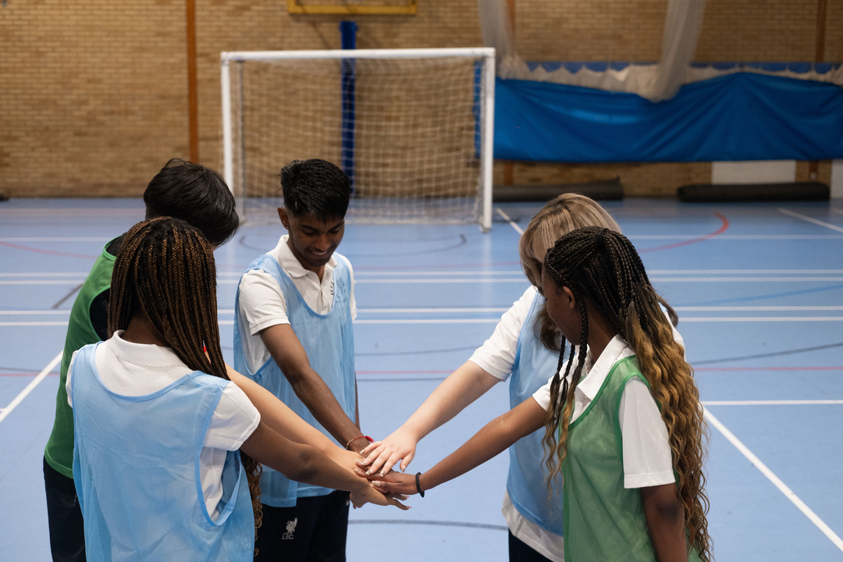
What if it’s a friend?
You don’t have to solve someone else’s problems.
You CAN:
❤️ Listen
💛 Take them seriously
🩷 Encourage them to talk to someone
💚 Encourage them to get support
🩵 Tell a trusted adult if you’re worried
about them or their safety
#TurnNLBlue
Notes:
Sometimes it won't be you who's struggling. It might be somebody you care about.
If a friend tells you they're having a difficult time, you might worry that you're responsible for fixing it.
You're not.
You don't need to have all the answers.
You can listen, take them seriously and encourage them to talk to somebody who can help.
Sometimes a friend might ask you to promise not to tell anyone.
But if you're worried about them or their safety, don't promise to keep it secret. Tell a trusted adult.
That's not betraying your friend. You're helping them get support.
And remember to look after yourself too. Supporting somebody who's struggling can be difficult and you're allowed to talk to somebody about how it's affecting you.
Optional question: If a friend told you they were struggling, what's something helpful you could say?

Slide 7


Why are we Turning Blue?
We are joining people across North Lincolnshire to Turn Blue for World Mental Health Day and:
💙 Raise awareness
💙 Start conversations
💙 Challenge stigma
💙 Support better mental health
in our community
💙 Show that mental health matters
#TurnNLBlue
Notes:
So why are we talking about all of this today?
For World Mental Health Day, we're joining people across North Lincolnshire to Turn North Lincolnshire Blue.
Turn North Lincolnshire Blue is a campaign from North Lincolnshire Mind, an independent local mental health charity supporting adults across North Lincolnshire.
Schools, colleges, workplaces, businesses, community groups and individuals are all being encouraged to get involved.
The idea is simple: use the colour blue to get people talking.
By Turning Blue, we can raise awareness, start conversations, challenge stigma, support better mental health in our community and show that mental health matters.
Our school/college is going to be part of it too.

Slide 8
What can you do? 💙
YOUR MISSION...
🎯 Start a conversation
🎯 Challenge stigma around
mental health
🎯 Check in with someone
🎯 Ask for help if you need it
🎯 Be kind to yourself
🎯 Do something that helps
your wellbeing
You never know what someone else is carrying.
Let’s make it easier to talk.
#TurnNLBlue
Notes:
We're going to finish with a challenge.
World Mental Health Day isn't just about wearing blue for one day.
Think about one small thing you could do.
Maybe you could start a conversation about mental health.
Maybe you could challenge stigma when you hear it.
Maybe you could check in with somebody.
Maybe you could ask for help if you're the person who needs it.
Or simply do something today that you know supports your own wellbeing.
None of us knows everything that another person might be dealing with.
We can't solve everything for each other. But we can help make it easier to talk.
So this World Mental Health Day, let's start conversations, look out for ourselves and each other and Turn North Lincolnshire Blue.
Thank you.

Slide 9
TURN
NORTH LINCOLNSHIRE
BLUE!
World Mental Health Day 2026
#TurnNLBlue
Nlmind.org/turnnlblue
Notes:
After the assembly
Students may want to talk about something the assembly has raised for them. Please ensure pupils know who they can speak to within your school or college and follow your usual safeguarding procedures if a concern or disclosure is raised.
North Lincolnshire Mind provides mental health support for people aged 17+.
Find out more at nlmind.org

