Slide 1




TURN
NORTH LINCOLNSHIRE
BLUE!
World Mental Health Day 2026
Today we are talking about our minds, our feelings and looking after ourselves.
#TurnNLBlue
Notes:
For Staff: This ready to use assembly is designed for Primary aged pupils and takes approx. 10 -15 mins to deliver. Optional discussion questions are included throughout and can be omitted for a shorter assembly. Please familiarise yourself with your school’s safeguarding and pastoral support arrangements before delivery.
Today we're going to spend a little bit of time talking about something that we all have - our mental health. When we hear the words ‘mental health’, we might think it only means somebody having a difficult time. But actually, we all have mental health, just like we all have physical health.
Today we're going to think about our feelings, some of the things that can help us look after our minds, how we can look out for each other, and why our school is taking part in Turn North Lincolnshire Blue for World Mental Health Day.
Optional question: Has anyone heard of World Mental Health Day before?

Slide 2
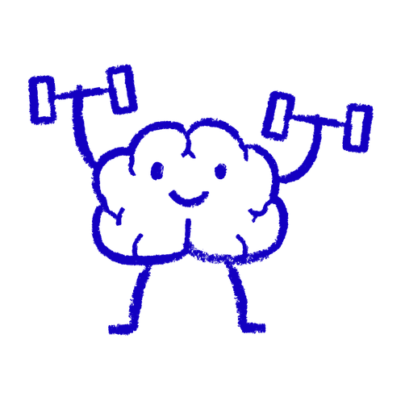
What is mental health?
We ALL have mental health.
It's about:
😊 How we feel
💭 How we think
🌱 How we cope with things
🤝 How we connect with other people
#TurnNLBlue
Notes:
So, what do we actually mean when we say mental health?
We all have physical health - that's about our bodies. And we all have mental health - that's about our minds and things like how we feel, how we think, how we cope with things that happen and how we connect with other people.
Sometimes we might feel happy and confident. Sometimes we might feel worried, angry, sad or overwhelmed. All of those feelings are part of being human.
Looking after our mental health is important for everybody.
Optional question: What are some things we do to look after our physical health?

Slide 3
How are you feeling today?
😁
😌
🤩
😟
HAPPY
CALM
EXCITED
WORRIED
😢
😠
😴
😕
SAD
ANGRY
TIRED
CONFUSED
All feelings are okay
#TurnNLBlue
Notes:
We can experience lots of different feelings.
We might feel happy, calm or excited. Sometimes we might feel worried, sad, angry, tired or confused.
And sometimes we can feel more than one thing at the same time!
Take a moment and look at the feelings on the screen.
How are you feeling today?
You don't need to tell anybody your answer - just have a think to yourself.
There aren't really “good” feelings and “bad” feelings. Some feelings are just harder or more uncomfortable than others.
What's important is learning to notice how we're feeling and knowing that there are things we can do (and people we can talk to) when feelings become difficult.
Optional question: Can anyone think of another feeling that isn't on the screen?

Slide 4
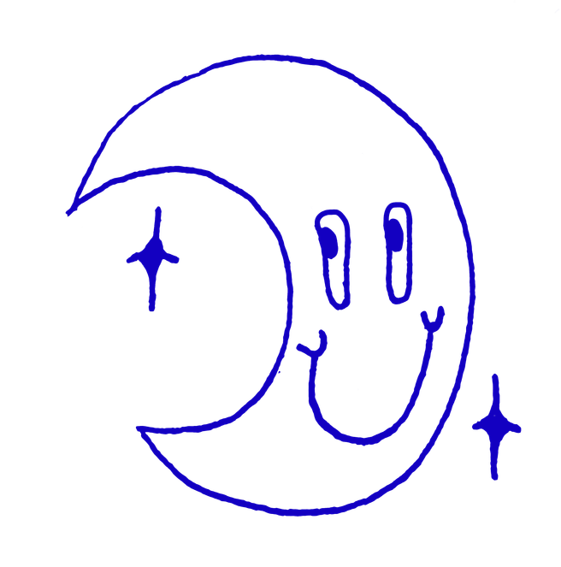

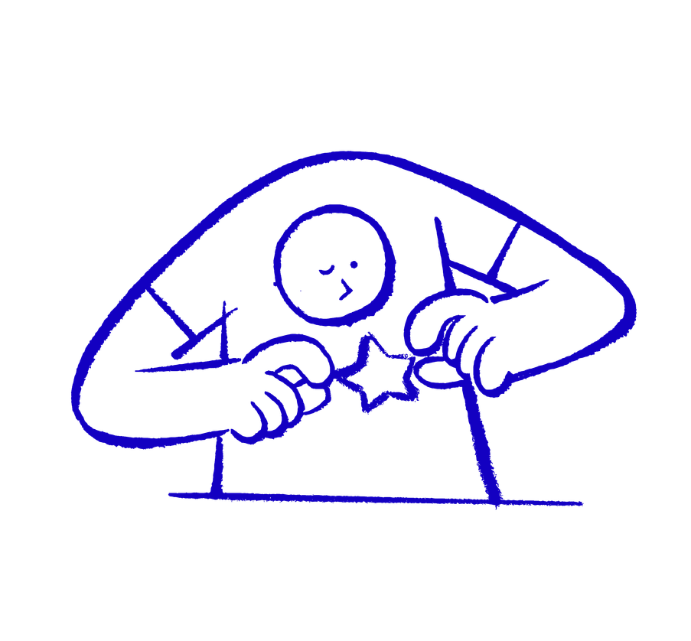

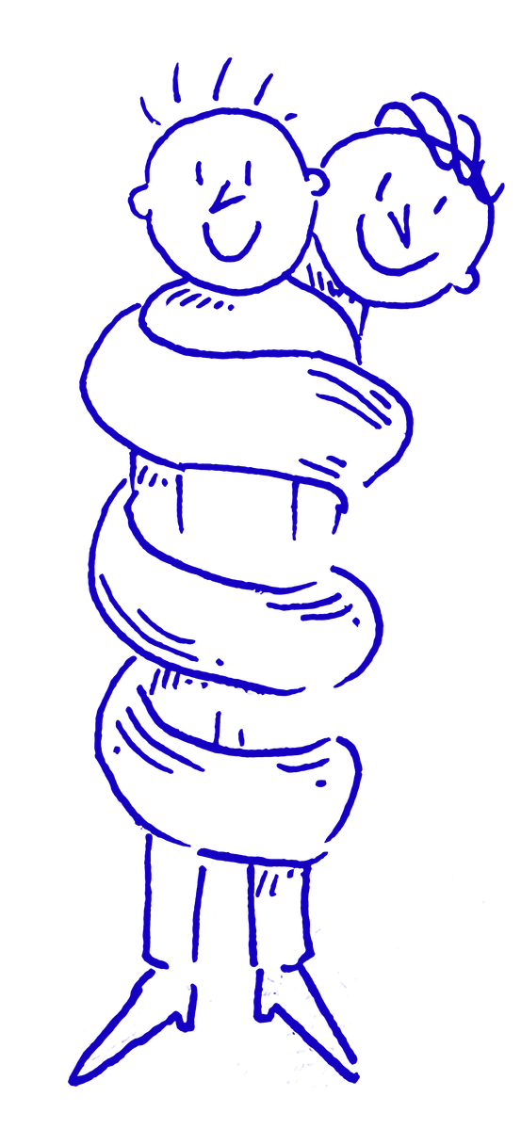

What helps our minds feel good?
Playing
Moving our bodies
Getting enough sleep
Talking about our feelings
Being creative
Spending time with people you care about
Being outside
Having quiet time
#TurnNLBlue
Notes:
There are lots of little things that can help us look after our mental health.
Have a look at the ideas on the screen.
We could play, move our bodies, get enough sleep, talk about our feelings, make or create something, spend time with people we care about, go outside or have some quiet time.
Different things work for different people.
One person might love going outside and kicking a football around. Someone else might prefer drawing, reading, listening to music or having some quiet time.
There isn't one ‘right’ way to look after our minds.
Optional question: What's something that helps you feel happy, calm or relaxed?

Slide 5
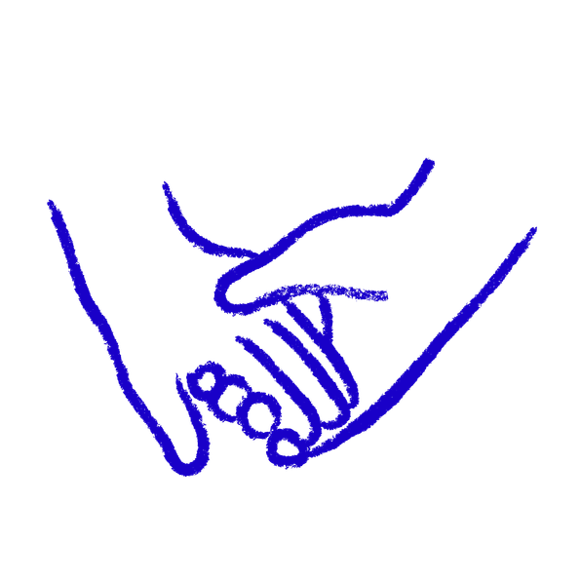
When things don’t feel okay
It’s okay to ask for help
You don’t have to deal with difficult feelings or worries alone 💙
Talk to someone you trust like:
A teacher
A parent/carer
Another trusted adult
#TurnNLBlue
Notes:
Sometimes doing the things we've just talked about can help us feel better.
But sometimes we might have a worry or difficult feeling that doesn't go away, feels too big to deal with on our own, or makes everyday things harder.
When that happens, remember:
You don't have to deal with difficult feelings or worries alone.
Talking to somebody you trust can help. That could be a parent or carer, your teacher, another member of staff at school, or another adult you trust.
And you don't have to know exactly what to say. You could simply say:
“I've been feeling worried and I'd like to talk to someone.”
You don't have to wait until a problem feels enormous before you ask for help.
It's always okay to tell someone how you're feeling.
Optional question: Without saying anybody's name out loud, can you think of an adult you could talk to if you were worried about something?
Note for staff: Before presenting, please identify the specific members of staff or pastoral support pupils can speak to within your school. Please follow your school's usual safeguarding procedures if a pupil raises a concern or makes a disclosure during or following the assembly.

Slide 6
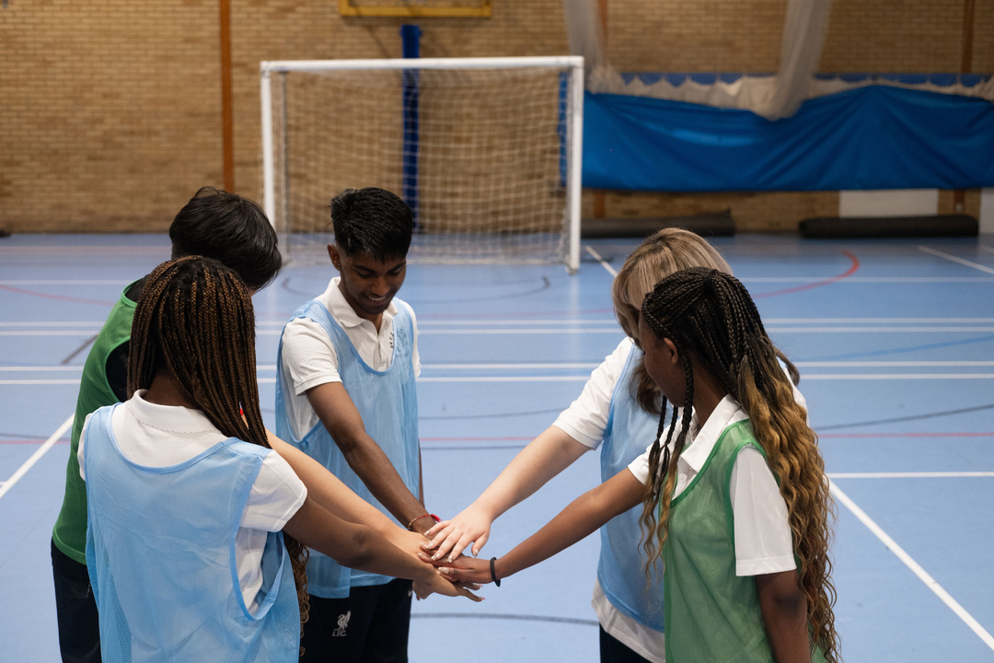
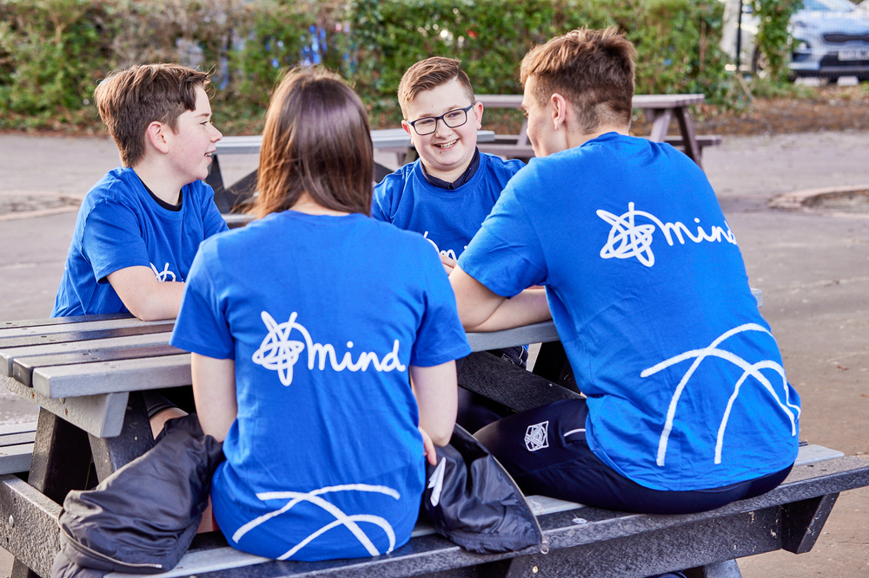
Looking out for each other
Sometimes a small act of kindness can make a big difference to somebody’s day
❤️ Include someone
💛 Listen
🩷 Say thank you
💚 Help someone
🩵 Ask ‘Are you okay?’
💜 Be kind
#TurnNLBlue
Notes:
Looking after our own mental health is important, but we can also look out for each other.
And that doesn't have to mean doing something enormous.
Sometimes a very small act of kindness can make a big difference to somebody's day.
Maybe you notice someone is on their own and invite them to join you. Maybe you listen when somebody wants to talk.
You could say thank you, help somebody, give someone a compliment or simply ask:
“Are you okay?”
We can't always know how somebody else is feeling just by looking at them.
And remember - you don't have to fix somebody else's problems. If you're worried about somebody, it's okay to tell a trusted adult.
Optional question: Can anyone think of one small act of kindness we could do at school today?

Slide 7
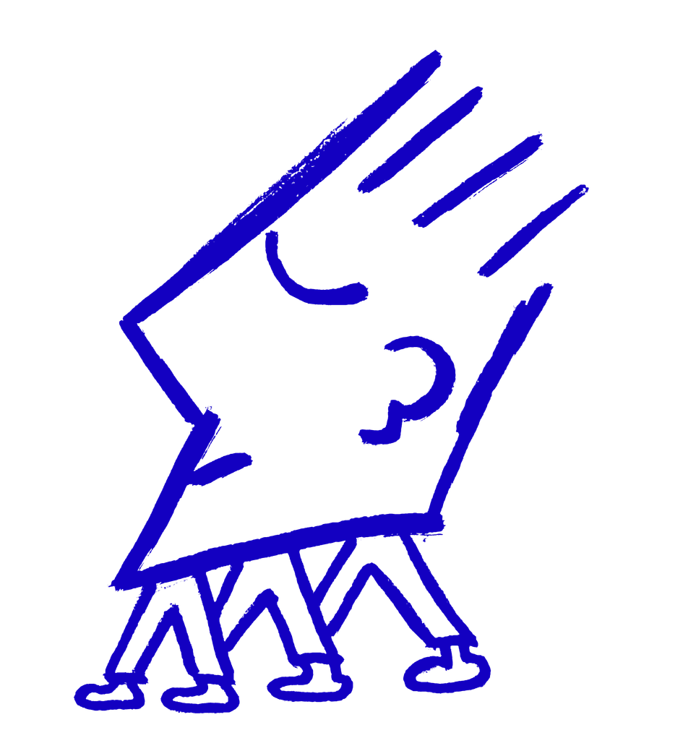
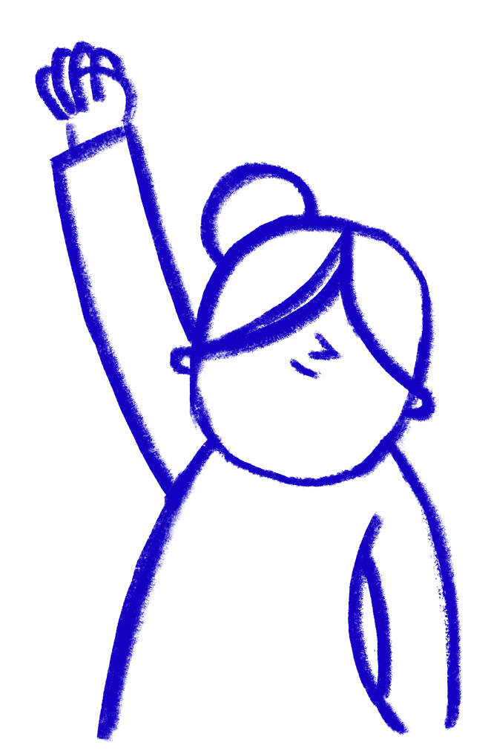
Why are we Turning Blue?
We are joining people across North Lincolnshire to Turn Blue for World Mental Health Day and:
💙 Raise awareness
💙 Start conversations
💙 Encourage kindness
💙 Show that mental health matters
#TurnNLBlue
Notes:
And this brings us to why we're talking about all of this today.
For World Mental Health Day, schools, workplaces, businesses, groups and people across North Lincolnshire are coming together to Turn North Lincolnshire Blue.
Turn North Lincolnshire Blue is a campaign from North Lincolnshire Mind, an independent local charity that supports adults in our community with their mental health.
We're Turning Blue to help raise awareness, start conversations, encourage kindness and show that mental health matters.
Lots of people across our community will be getting involved - and our school is going to be part of it too!

Slide 8
The Blue Kindness Challenge 💙
YOUR MISSION...
Do ONE thing today to brighten someone's day!
🎯 Talk to someone new
🎯 Help somebody
🎯 Thank someone who
has helped you
🎯 Ask someone how they are
🎯 Make someone smile
🎯 Do something that makes
you smile
How many acts of kindness can our school create today?
#TurnNLBlue
Notes:
We're going to finish with the Blue Kindness Challenge.
Your mission is to do ONE thing today to brighten somebody's day.
You could talk to someone at school you don't usually talk to, help somebody, thank someone who's helped you, ask somebody how they are or make somebody smile.
Or you could do something kind for yourself too.
Imagine if every person in our school did just one small act of kindness today.
How many acts of kindness could we create together?
And remember, looking after our mental health isn't something we only do on World Mental Health Day.
We can look after ourselves and each other every day.
So that's your challenge:
Do one small thing today that makes a difference.
Thank you, and let's Turn North Lincolnshire Blue!

